Slide 1


Covid-19
Crime Analysis
Nehemiah Dang
Joseph Scott
Kay Royo

Slide 2


Why COVID-19? Why crime?
Worldwide crisis
Do people follow protocol for shelter-in-place?
Ring security camera
Hypothesis: Does crime slow down because of COVID-19 outbreak?
Notes:
Speaker: Nemo

Slide 3

Tools Used
Pandas
Matplotlib
Jupyter Notebook
API
Gmaps
CSV
Numpy
Excel

Slide 4

Highest Number of Cases
in the U.S. as of 4/18/2020
New York: 235,395
New Jersey: 78,467
Massachusetts: 34,402
Michigan: 30,023
Pennsylvania: 30,031
California: 29,425
Illinois: 27,577
Florida: 24,759
Louisiana: 23,118
Texas: 18,078
Notes:
Speaker: Joseph
Sourced from CNN

Slide 5
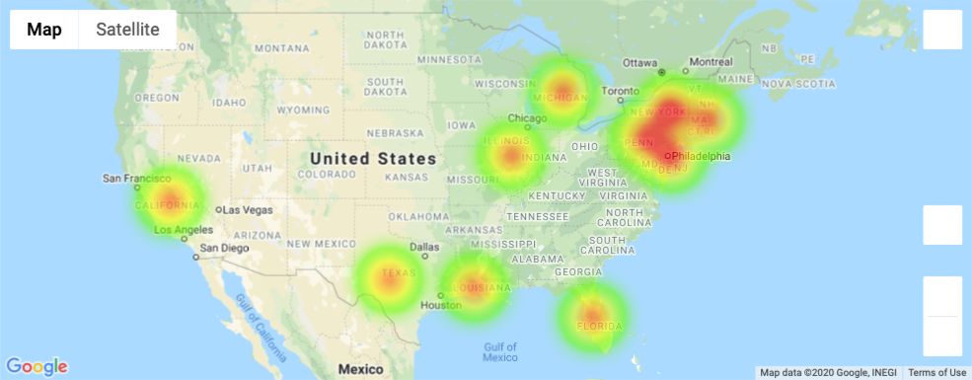
The Outbreak
Notes:
Speaker: Kay

Slide 6
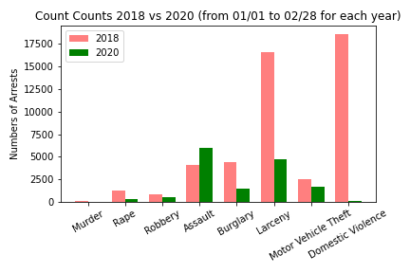
Detroit Crime Analysis - Major Seven & Domestic Violence from 01/01 - 02/28
Notes:
Speaker: Nemo

Slide 7
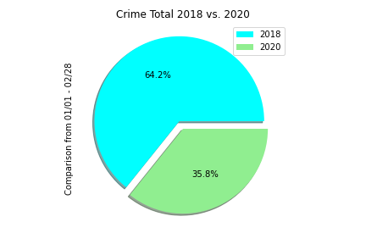
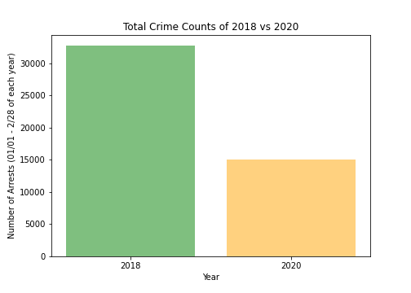
Detroit Crime Analysis: 2018 vs 2020
Notes:
Speaker: Nemo

Slide 8
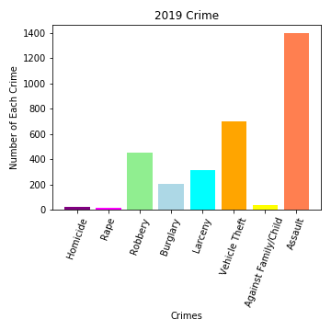

LA: Crime Analysis - Top 8 Crimes
From Jan. 1 - Mar. 31
Notes:
Speaker: Joseph

Slide 9
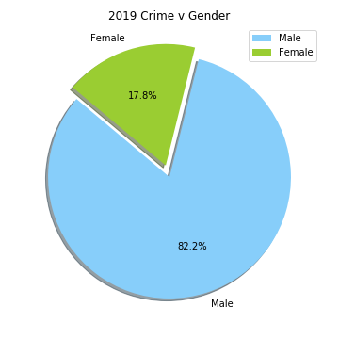
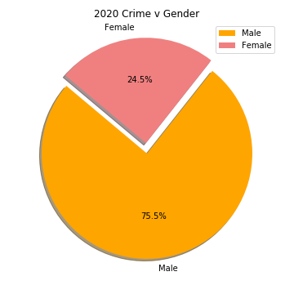
LA: Crime Analysis - Gender
From Jan. 1st - Mar. 31
Notes:
Speaker: Joseph

Slide 10
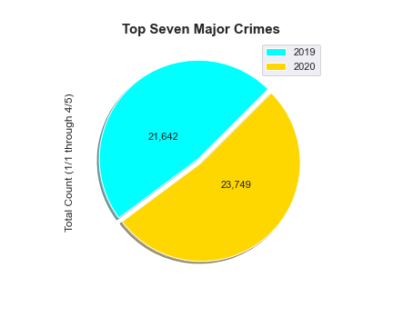
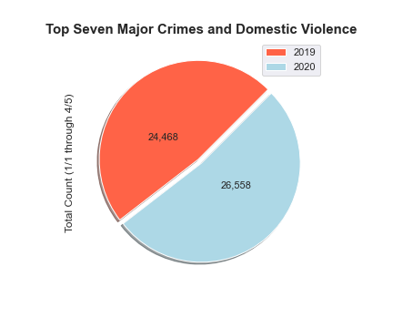
NYC Crime Analysis: 2019 vs 2020
% change = +9.74
% change = +8.54
Notes:
Speaker: Kay

Slide 11
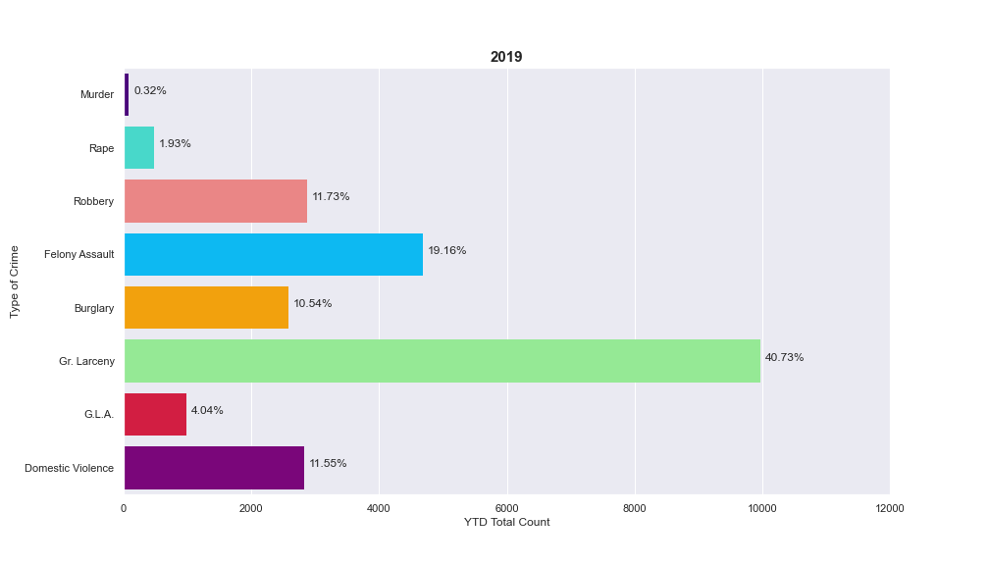
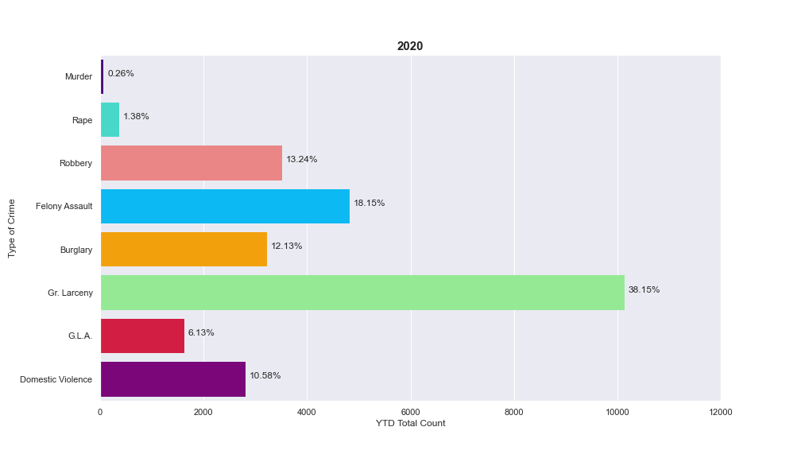
NYC Analysis: Crime Breakdown
Notes:
Speaker: Kay

Slide 12
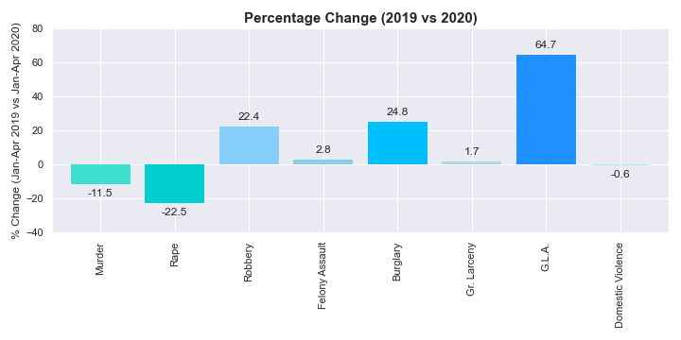
NYC Crime Analysis: 2019-2020 Percent Change
Notes:
Speaker: Kay

Slide 13


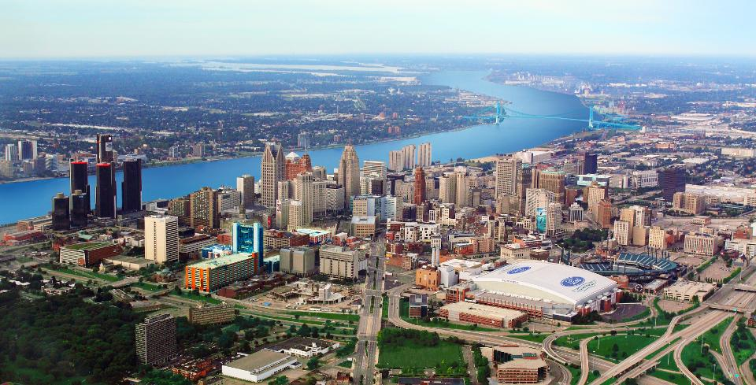
Summary
Los Angeles
Displaying an overall decrease in the amount of crimes recorded over the same 3 month time frame. Does not account for cases not recorded.
New York
The shelter-in-place protocol has caused a slight increase of 9-10% in top seven major crimes and domestic violence combined.
Detroit
While there’s a decrease in crime overall, there’s a fluctuation in other types of crime.
Notes:
“Crime during COVID has Decreased while Netflix watching has skyrocketed!” - deleted since it slightly increased in New York

Slide 14

Before You Go!
Safety Tips:
Go big and go home!
Practice Social Distancing
Go Super Saiyan on your hands!
Stay home and stay away from corona and crimes!
Do not touch your face!

Slide 15
References
https://www.cnn.com/interactive/2020/health/coronavirus-us-maps-and-cases/
https://data.lacity.org/A-Safe-City/Arrest-Data-from-2010-to-Present/yru6-6re4
https://www.latlong.net/category/states-236-14.html
https://www.michigan.gov/msp/0,4643,7-123-1586_3501_4621-502382--,00.html
https://data.detroitmi.gov/datasets/rms-crime-incidents/data?geometry=-83.680%2C42.264%2C-82.518%2C42.442&where=year%20%3E%3D%202018%20AND%20year%20%3C%3D%202020
https://compstat.nypdonline.org/2e5c3f4b-85c1-4635-83c6-22b27fe7c75c/view/90
https://www1.nyc.gov/site/nypd/news/p0402b/nypd-citywide-crime-statistics-march-2020

